Slide 1
Alignement d'ontologie pour la gestion de données de traits du blé tendre
Claire Nédellec, Sophie Aubin, Clara Sauvion, Liliana Ibanescu, Sonia Bravo, Jacques Le Gouis, Thierry C. Marcel, Cyril Pommier, Robert Bossy, Michaël Alaux
Séminaire semantic linked data, 10-13 oct 2023

Slide 2
Le blé tendreTriticum aestivum
Production
Deuxième céréale la plus produite après le maïs, avec 780 millions de tonnes en 2022
En 50 ans, la production a triplé
Sélection
Variétés plus résistantes aux maladies et aux aléas climatiques
Variétés nécessitant moins d'intrants
Variétés pour de nouvelles utilisations alimentaires
Génétics
La génétique accélère la sélection de nouvelles variétés
L'un des génomes les plus complexes et les plus longs (17 Gpb)

Slide 3
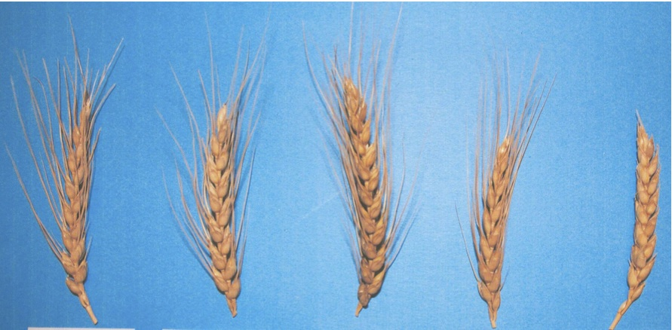
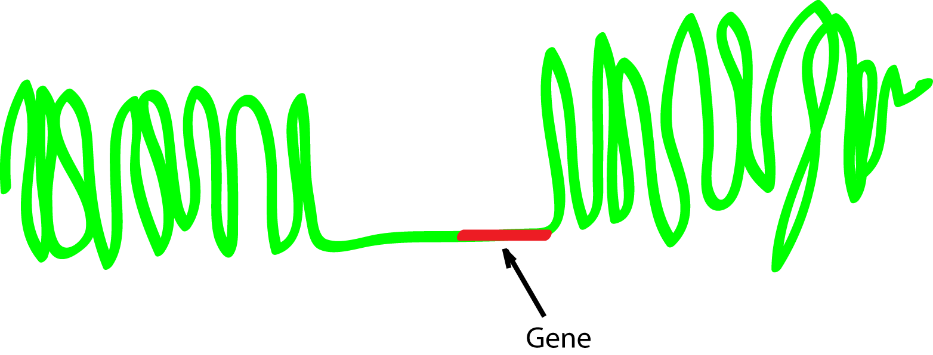
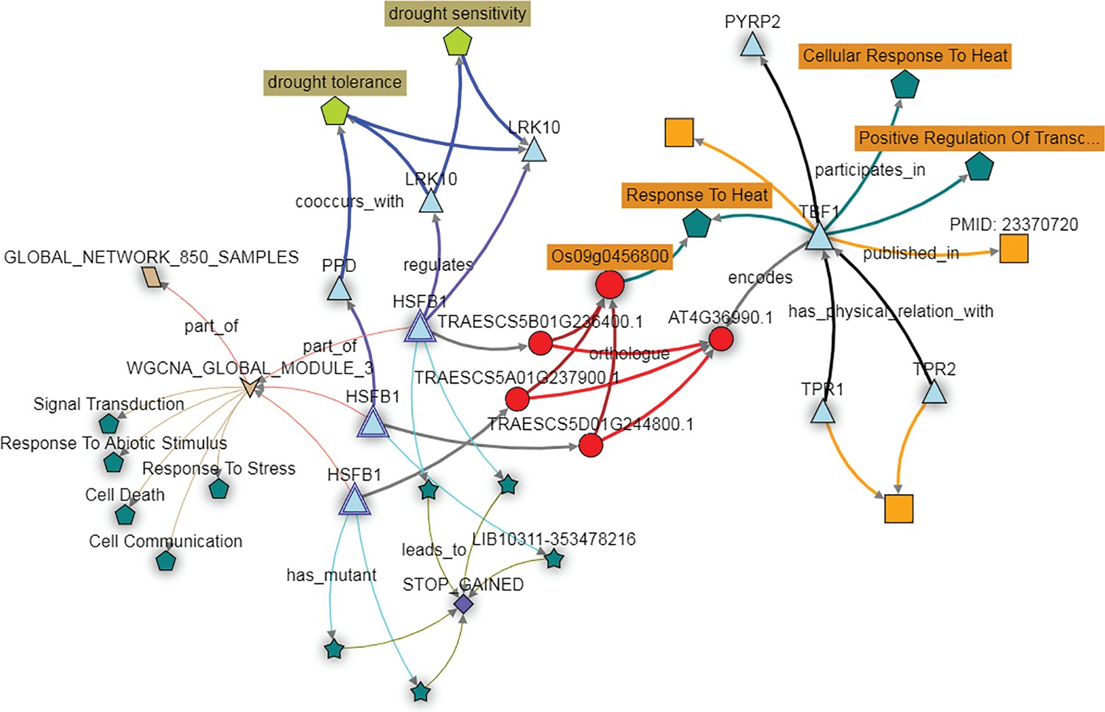
Phenotypage - genotypage, sélection
Les gènes contrôlent les caractéristiques, les traits des variétés de blé (par exemple, la longueur de barbe).
Les allèles du gène déterminent sa valeur, les phénotypes (par exemple, absence de barbe).
Pixabay
Adamski et al, eLife 2020

Slide 4
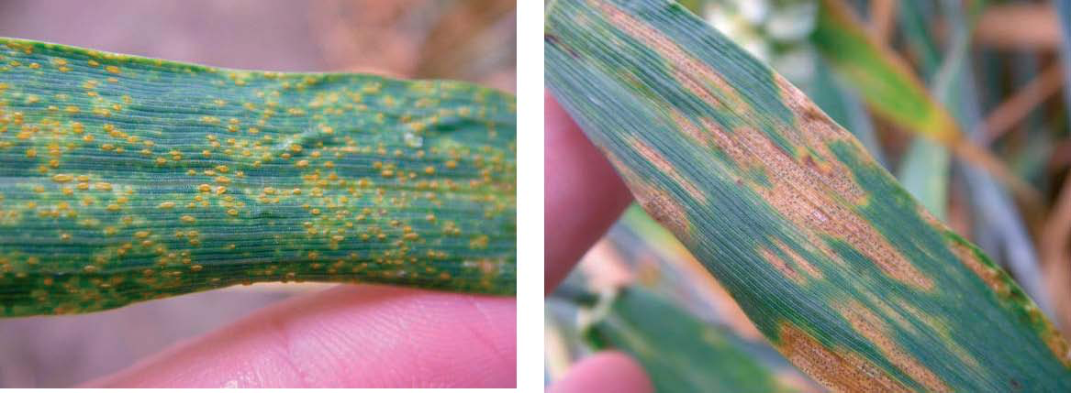
Un exemple de valeur phénotypique : susceptibilité à la rouille des feuilles (susceptible to leaf rust)
Trait correspondant : resistance to leaf rust

Slide 5
Données expérimentales et textes - des sources d'information complémentaires
Cultivar
Trait
These assays included inoculation with three different pathotypes on a segregating population originating from a cross between cv. Apache and cv. Taldor, a French cultivar susceptible to stripe rust
moderatley tolerant to stripe rust
highly resistant to stripe rust
…
Articles scientifiques
Observed leaf rust score
Ensemble de données phénotypiques expérimentales

Slide 6
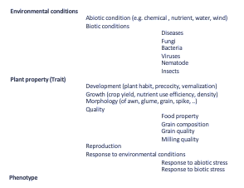
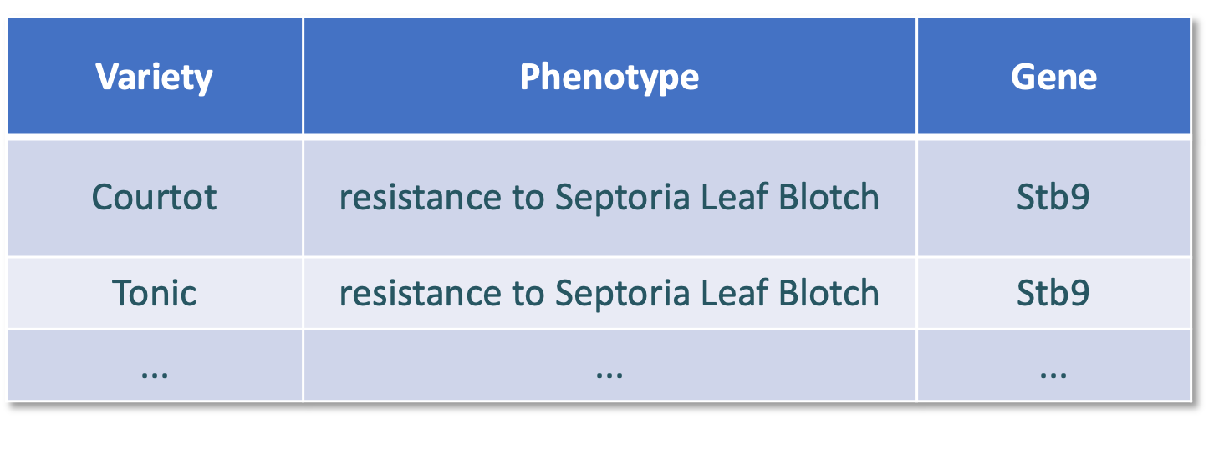
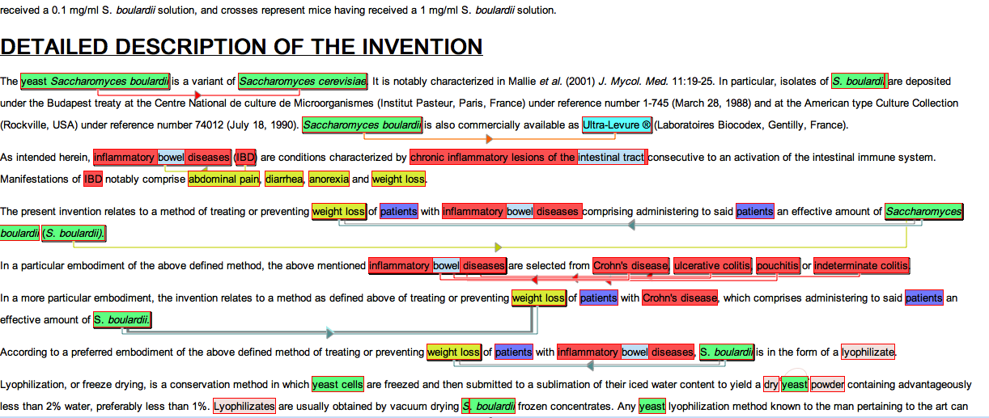
Des technologies du web sémantique pour une base de connaissance unifiée
Données phénotypiques et information de la littérature sur les génotypes de blé tendre
Requête utilisateur
?
Crop ontology
CO_321
Wheat Trait and Phenotype Ontology WTO
Récupération d'informations interopérables de manière conviviale
Annotation sémantique de la littérature sémantique
Composants
(1) Indexation et lifting de données expérimentales
(2) Annotation sémantique de la littérature et lifting
(3) Alignement des classes d'ontologie et lifting
(4) Conception du graphe de connaissance
Données expérimentales

Slide 7
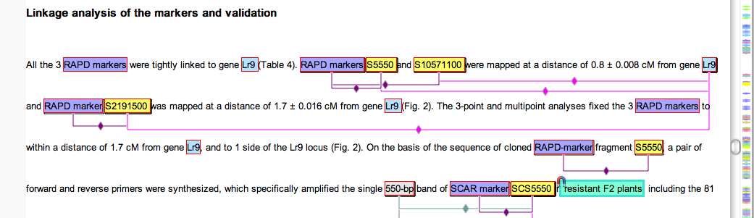
(3) Information de phénotype et de trait, deux ontologies complémentaires
WTO
CO_321
Wheat Trait&Phenotype Ontology
753 traits et phenotypes
Structure profonde : 9 levels
Crop Ontology du blé
Observation variables
Structure plates : 3 levels
trait +method+scale
460 classes de trait
http://agroportal.lirmm.fr/ontologies/WHEATPHENOTYPE
Crop Ontology for agricultural data
Template and Guidelines :
www.cropontology.org

Slide 8
Recherche des traits d'une variété dans des données textuelles et expérimentales
Query: all data about Resistance to STBin in all Wheat varieties
Interprétation sémantique
WTO_554: resistance to Septoria Leaf Blotch
CO_321:715 Septoria blotch plant response
WTO
CO_321
Mapping
Variety | Trait
Courtot | WTO_554
Tonic | WTO_558
... | ...
Accession ID | CO_321:715
RE11058 | 5
CF11150 | 7
Données expérimentales
Information du texte
alignement des phénotypes de WTO et des valeurs des variables de CO_321, à venir

Slide 9
Mixing scientific information and local experimental observations?
Some cautions
Scientific articles describe information with a broader scope confirmed by experiments
Local observations at the field scale with a limited scope are not always generalizable
Different truth values
Expected properties of the target Information System
No blind fusion of the data but
Presents the data from different sources with their respective scopes
Highlights the complementarities
Supports an informed interpretation by the user

Slide 10
Mécanisme de recherche d'information
Exemple
WTO
CO_321
trait
Wheat trait
Quality
Quality trait
Grain composition
Milling quality
Milling quality
Flour yield
Grain glutent content
Amount of damaged starch
Moisture content of the grain
Query: All data about « milling quality » of wheat varieties?
Renvoie les données indexée par toutes les classes subsumées
WTO:Milling quality CO:Milling quality
WTO:Moisture content of the grain
WTO:Amount of damaged starch
les classes plus spécifiques de WTO

Slide 11
Mécanisme de recherche d'information
Exemple
WTO
CO_321
trait
Wheat trait
Deux classes alignées WTO:C and CO:C' peuvent avoir des ancêtre non alignés
Strategie
Union des données indexées par
toutes les classes plus spécifiques (récursivement)
toutes les classes équivalentes et leurs classes subsumées.
Agronomical trait
Quality
Quality trait
Milling quality
Milling quality
Grain moisture content
Amount of damaged starch
Moisture content of the grain
Query: All data about « Milling quality » of wheat varieties ?
Renvoie les données indexées par toutes las classes subsumées = sous-arbres des classes:
WTO: Milling quality CO:Milling quality
WTO:Moisture content of the grain CO:Grain Moisture content
WTO:Amount of damaged starch
more specific classes in WTO
equivalent class in CO

Slide 12
Mécanisme de recherche d'information
Alignement assymétrique
WTO
CO_321
trait
Wheat trait
CO:class est plus générale que toutes les classes de WTO (ou le contraire)
Strategie
Alignement assymétrique
Subsomption, mais pas equivalence
Agronomical
trait
Crop yield
+ specific
Thousand kernel weight
Grain weight
+ general
Assymetric mapping
Query: All data about « Grain weight» of wheat varieties?
Renvoie les données indexées par :
WTO: Thousand kernel weight CO: Grain weight
Query: All data about « Thousand kernel weight» of wheat varieties?
Renvoie les données indexées par :
CO: Thousand kernel weight

Slide 13
Data retrieval mechanism
Phenotypes classes of WTO
missing in CO_321
WTO
CO_321
Phenotype
trait
Wheat trait
Phenotypes
Phenotype classes in WTO are linked by the relation Trait_has_value
No Phenotype class in CO_321
Strategy
Phenotype classes in WTO are viewed as subsumed classes of trait classes
Development
Phenological
Late heading
Early heading
trait_has_value
Ear emergence
Ear emergence time
trait_has_value
Query: All data about « Ear emergence» of wheat varieties?
Data indexed by all subsumed classes= class subtrees:
WTO: Ear emergence time CO:Ear emergence
WTO:Early heading
WTO:Late heading

Slide 14
Typologie des alignements et justifications
0 The classes are different
1 The classes are equivalent
1.1 The classes have the same label or are slightly different, but have the same sense
1.2 The classes share labels or synonyms
1.3 The classes have different labels, but their definitions are similar, or the definition includes a label or synonym of the other class
1.4 The classes are equivalent with respect to formal rules
1.5 The mapping uses supplementary information (e.g., reference)
4,5,6 Complex mapping (not detailed here)
7 The CO_321 class is more general than the WTO class, and there is no relevant, more specific class
8 The WTO class is more general than the CO_321 class, and there is no relevant, more specific class
Exemples de classes alignées
WTO:plant height CO_321:plant height
WTO:plant habit CO_321:plant growth habit
WTO:glutenin content CO_321:glutenin Glu-D3 composition
WTO:above-ground dry matter quantity CO_321:aboveground biomass
exact
exact
+ gen.
+ spec.

Slide 15
Methode d'alignement de classes
Automatic tools tested find obvious string-matched pairs → Manual mapping.
We reused the mappings of WTO and WIPO (ancestor of CO_321) from a previous project
We defined general rules for class label rewriting
Discussion and review (recorded as Gitlab issues)
More than 60 questions that required expertise in wheat breeding
We recorded justification and references to external sources
Consistency checking

Slide 16
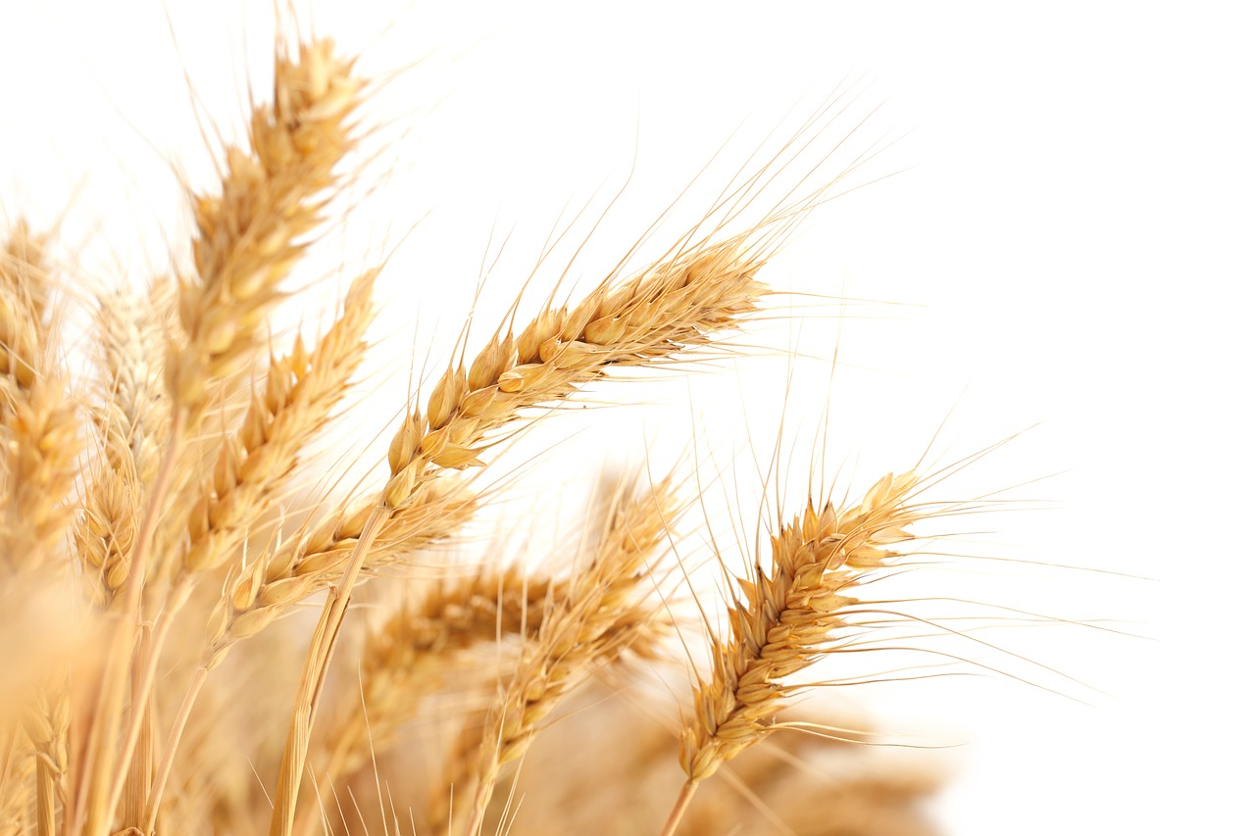
Manual mapping of the classes of CO_321 and WTO
WTO more gen.
WTO more gen.
CO_321 classes without mappings (type 0)
- topics absent from WTO (e.g. canopy traits)
- non trait classes (e.g. date, sample)
WTO classes without mappings (type 0)
- topics absent from CO_321 (e.g. root architecture)
- high-level classes (9 levels)

Slide 17
Multiple mappings
Mappings may be not one to one,
Examples
a single disease in one ontology may be represented by several diseases considered distinct in the other, yielding several traits
biotic stress traits in CO_321 are decomposed along plant parts (grain, root, stem), they are not in WTO
traits in CO_321 are broken down by method type (severity, score, response, index), not in WTO
ID WTO | WTO label | Mapping code | Rule | ID CO_321 | CO_321 Label
WTO_0000483 | resistance to Fusarium head blight | 1 | 1,4 | CO_321:0000924 | Fusarium graminearum incidence
WTO_0000483 | resistance to Fusarium head blight | 7 |  | CO_321:1010097 | Fusarium score post fusarium inoculation
WTO_0000483 | resistance to Fusarium head blight | 1 | 1,4 | CO_321:0000926 | Fusarium graminearum severity
WTO_0000483 | resistance to Fusarium head blight | 1 | 1,4 | CO_321:0000925 | Fusarium graminearum plant response
WTO_0000483 | resistance to Fusarium head blight | 1 | 1.4, 1.5 | CO_321:0000929 | Fusarium head blight spike response
WTO_0000483 | resistance to Fusarium head blight | 1 | 1,4 | CO_321:0000651 | Fusarium head blight AUDPC
WTO_0000483 | resistance to Fusarium head blight | 1 | 1,4 | CO_321:0500021 | Fusarium head blight ISK index
WTO_0000483 | resistance to Fusarium head blight | 1 | 1,4 | CO_321:0500019 | Fusarium head blight disease index
However, we want the inference system to retrieve the data indexed by these class couples, just if they were equivalent

Slide 18
Distribution of multiple mappings
Assymetric mappings

Slide 19
Class mapping rules
Label mapping follows formal rules
They formalize the rationale for the mappings
with an objective of consistency.
Examples of biotic stress trait class mapping rules
Score
resistance to + ’name of disease’ (WTO) ↔ ’name of disease’ + score (CO_321)
Example: WTO: resistance to Septoria Leaf Blotch (WTO:554) ↔ CO_321:Septoria score on leaf (CO_321:1010036)
Severity
resistance to + ’name of disease’ (WTO) ↔ ’name of disease’+ severity (CO_321)
Example: WTO: resistance to Powdery Mildew (WTO:551) ↔ CO_321:Powdery mildew severity (CO_321:0000939)
Incidence + part of plant (name of disease)
resistance to + ‘name of disease’ (WTO) ↔ ‘name of disease’ + part of plant +incidence (CO_321)
Example: WTO: resistance to Fusarium head blight (WTO:0483) ↔ CO_321:Fusarium head blight spikelet incidence (CO_321:0000711)

Slide 20
Mapping information in tsv

Slide 21
Conversion of Obo WTO representation into RDF for the formalization of the aligment
Conversion of WTO from Obo to RDF
From Obo format to SKOS and OWL for the integration in the knowledge graph
How to choose the appropriate format SKOS or OWL, for each Obo class?
Principle
Observable properties should be represented by SKOS concepts
Non-observable traits and environmental factors should be represented by OWL classes

Slide 22
WTO RDF model heuristics are based on class mapping (ongoing)
Some of the heuristics for determining observable properties in a semi-automatic way
H1: WTO phenotype classes are observable properties
H2: SKOS traits of CO_321 are all observable properties, then WTO traits that map a CO_321 concept (equivalent or more specific) are observable properties
H3: leaves of the Environmental property subtree are all observable then skos:Concept
H4: WTO traits whose siblings are skos:Concept are themselves skos:Concept
A
B
D
E
C
H
G
F
I
1
2
4
5
3
6
H4
H2

Slide 23
Mapping heuristics exceptions
WTO is not complete → the application of H3 and H4 heuristics has to be manually checked
Exception to H3: Leaves of the Environmental subtree may be high-level classes. They are roots of future subtrees to be developed further. They should therefore be represented as owl classes.
Exception to H4: General classes may have specific skos:Concept sibling. They may be roots of future subtrees and should therefore be represented as owl classes
A
B
D
E
G
F
C
H
1
2
4
5
3
6
H2 mapping
H4
H4
H4

Slide 24
SSSOM : Simple Standard for Sharing Ontology Mappings
Par qui ?
Communauté biomédicale, OBO Foundry
intérêt pour SSSOM dans l’European Open Science Cloud
Pourquoi ?
Avoir des mappings FAIR
Etablir un catalogue de métadonnées riches pour les mappings
Pouvoir avoir des informations de provenance, sur les méthodes, le niveau de confiance…
Remplacer hasDbXref
Volonté d’avoir un modèle simple à utiliser.
Serialisation en RDF/OWL pour la communauté web sémantique
TSV pour une communauté plus large
https://mapping-commons.github.io/sssom/
Journées scientifiques D2KAB - 14 mars 2023 - S. Aubin
Notes:
Alignment format https://moex.gitlabpages.inria.fr/alignapi/format.html
EDOAL : Expressive and Declarative Ontology Alignment Language https://moex.gitlabpages.inria.fr/alignapi/edoal.html

Slide 25
Mapping Model
predicate_id
subject_id
object_id
skos:exactMatch
WTO_0000086
CO_321:0000034
Journées scientifiques D2KAB - 14 mars 2023 - S. Aubin

Slide 26
Mapping Model
owl:sameAs, owl:equivalentClass, owl:equivalentProperty
rdfs:subClassOf, rdfs:subPropertyOf
skos:exactMatch, skos:narrowMatch, skos:closeMatch, skos:relatedMatch, skos:broadMatch
oboInOwl:hasDbXref
rdfs:seeAlso
ou toute autre propriété d’alignement déclarée dans une ontologie, un schéma
predicate_id
subject_id
object_id
skos:exactMatch
WTO_0000086
CO_321:0000034
Journées scientifiques D2KAB - 14 mars 2023 - S. Aubin

Slide 27
Mapping information formalized into
owl:sameAs, owl:equivalentClass, owl:equivalentProperty
rdfs:subClassOf, rdfs:subPropertyOf
skos:exactMatch, skos:narrowMatch, skos:closeMatch, skos:relatedMatch, skos:broadMatch
oboInOwl:hasDbXref
rdfs:seeAlso
or any mapping property declared
in an ontology or schema
Replace hasDbXref
Serialisation in RDF/OWL
Comment
mapping_justification
mapping_date
author_id
“Same class name”
HumanCurated
29.05.2021
Description of
the mapped objects
the mapping
the provenance
orcid:0001-.....
reviewer_id
predicate_id
subject_id
object_id
Mapping Model (extract)
orcid:0001-.....
skos:exactMatch
WTO_0000086
CO_321:0000034
mapping_cardinality
subject_label
match_term_type
object_label
1:1
response to abiotic stress
ConceptMatch
Abiotic stress
from S. Aubin, D2KAB - 14 mars 2023
https://mapping-commons.github.io/sssom/

Slide 28
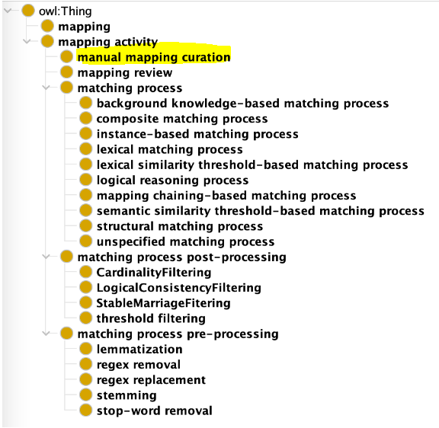
SEMAPV: A Vocabulary for Semantic Mappings
SSSOM vient avec un vocabulaire contrôlé pour renseigner certaines propriétés
sssom:mapping_justification
https://github.com/mapping-commons/semantic-mapping-vocabulary
Journées scientifiques D2KAB - 14 mars 2023 - S. Aubin

Slide 29
WTO-CO_321 mapping representation choices in SSSOM
Will be shortly published on AgroPortal
Skos mappings
Equivalent
code 1 → skos:exactMatch
More general/more specific
code 7 → skos:broadMatch
code 8 → skos:narrowMatch
A
B
D
E
C
H
G
F
owl equivalentClass
1
2
4
5
3
6
skos:exactMatch
OWL mappings
Equivalent
code 1 → owl:equivalentClass
More general/specific
code 7, 8 → rdfs:subClassOf
author ID, author label, reviewer ID reviewer Label, mapping_Date
automatically inferred from the metadata
Evolution of SSSOM wrt our needs
Formalization of the mapping rules (currently free text)
Specification of the use scope

Slide 30
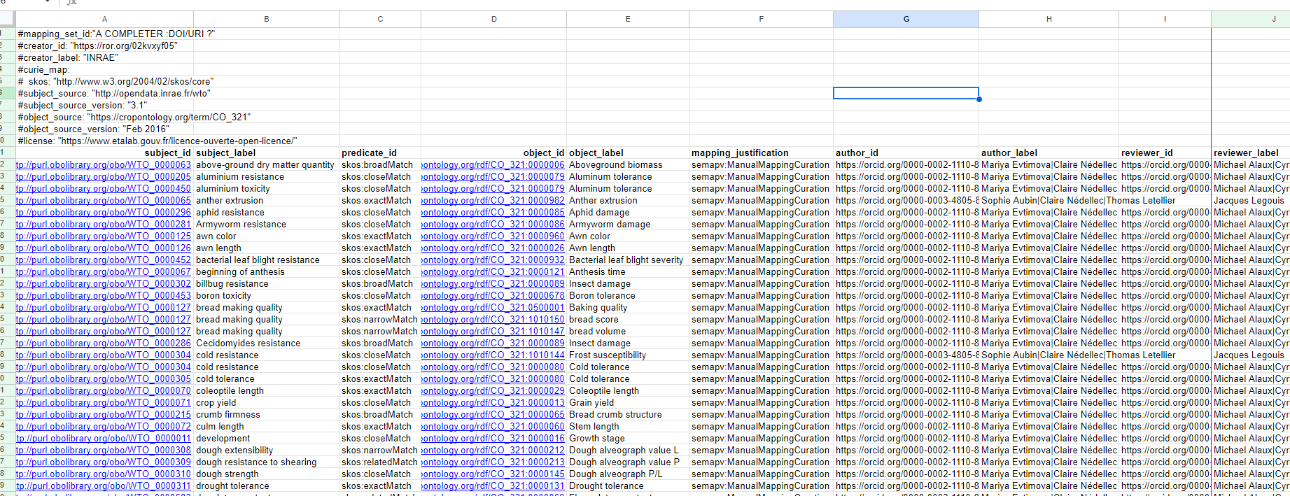
WTO - CO_321 mapping extract in SSSOM formalism

Slide 31
Discussion
Besoin de représentation des correspondances multiples
Choix de equivalentClass, non formellement valide
Quelle représentation choisir ?
Représentation des correspondances assymétriques inférentielles (plus général, plus spécifique)
Par rdfs:subClassOf (entre classes owl)
skos:broadMatch (entre concepts SKOS)
skos:narrowMatch
Besoin de représentation explicite du cadre d'usage
Les correspondances sont valides pour un certain usage, ici la recherche d'information indexées par les ontologies

Slide 32
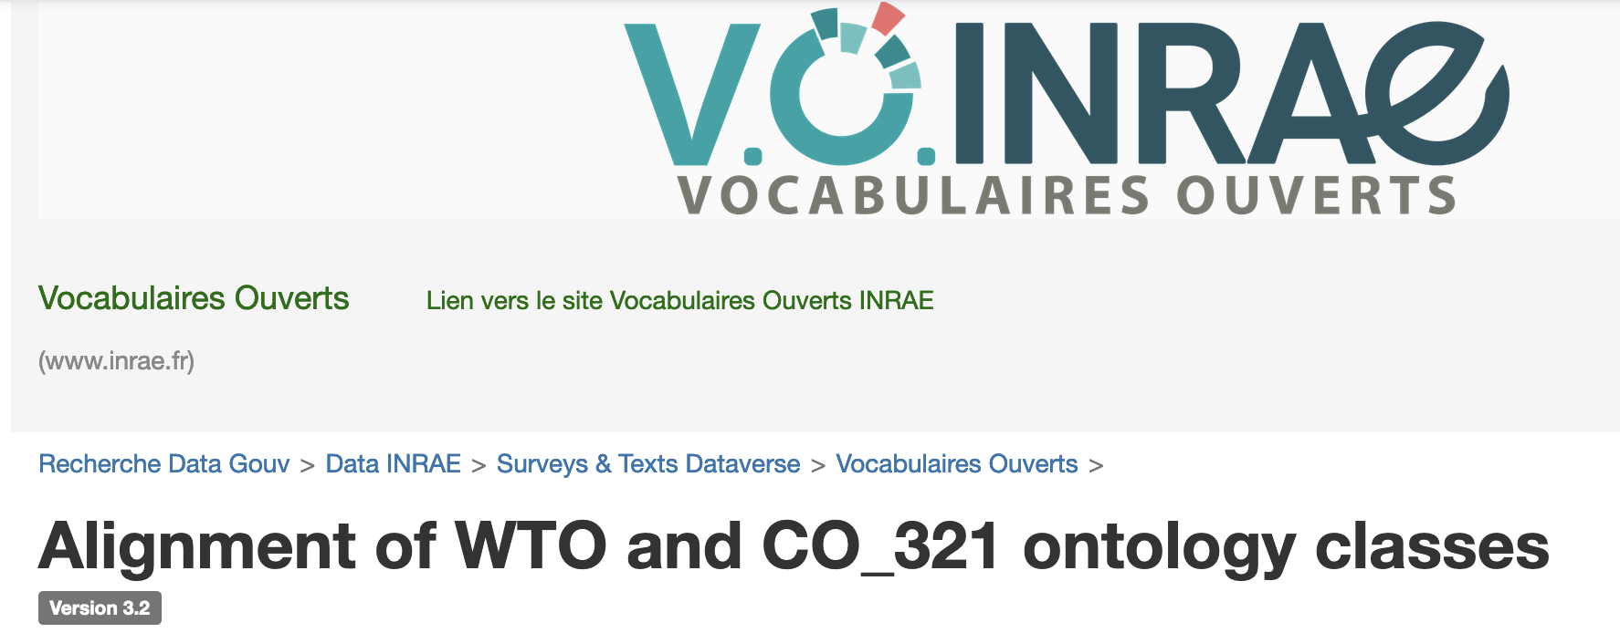
Valorisation
Article DataInBrief en cours de rédaction
Publication des alignements au format tsv sur recherche.data.gouv doi:10.57745/ZLJYQO
Publication des alignements au format SSSOM à venir
Publication sur AgroPortal, à venir

Slide 33
Final knowledge graph (on going)
Ontologies
WTO in obo
CO_321 in RDF and tsv
conversion
done
Mapping
conversion
done
done
Short-term
Unified knowledge graph
User representative queries
Full-scale tests
WTO in owl and SKOS
CO_321 in owl and SKOS
SSSOM mapping
Indexing
done
Indexing
done
textual data lifted
experimental data lifted
Lifting
done
Data
Lifting
done
Structured textual data (entity, classes, relations)
Experimental data (tuples)

Slide 34
INRAE MaIAGE
Claire Nédellec
Clara Sauvion
Robert Bossy
INRAE URGI
Michaël Alaux
Cyril Pommier
AgroPortal
Clément Jonquet
DIPSO
Sophie Aubin
Sonia Bravo
INRAE BIOGER
Thierry Marcel
INRAE GDEC
Jacques Legouis
Pierre Sourdille

